Slide 1
Amazon Kinesis and AWS Lambda
Prachi Sankpal
Rashika Singh
Sheetal Chowdhary

Slide 2
Amazon Kinesis
Amazon Kinesis allows you to easily collect, process and analyze real-time streaming data to get timely insights and quickly analyze information
It can ingest data such as audio, video, application logs, website streams and IOT data
Amazon Kinesis services:
Kinesis Video Streams
Kinesis Data Streams
Kinesis Data Firehose
Kinesis Data Analysis
Notes:
Business today receive massive amount of data at a massive scale from various data sources that continuously generate streams of data. Enterprises are eyeing to extract precise insights on a real-time or near real-time from the unstructured data to deliver value and growth to their business. Unstructured data can be from any available sources to the business, such as application logs, telemetry, social feeds, Internet Of Thing (IOT) etc. Amazon Kinesis service is the central suite of the architecture to address the real-time , data ingestion needs.Kinesis allows you to run all streaming applications without having to deploy and maintain infrastructure.

Slide 3
Kinesis Video Streams
Kinesis video streams allows you to easily stream videos photos from connected devices to AWS for analytics, ML and other processes
It streams provisions and scales the infrastructure needed to ingest the data from multiple devices
Notes:
Kinesis Video Streams: Enables streaming video from connected devices to AWS for analytics, machine learning (ML) playback, and other processing.

Slide 4
Kinesis Data Streams
Kinesis data streams is a real-time data streaming services from website clickstreams, database event streams, financial transactions, social media feeds, IT logs, and location-tracking events
This data is further used for analytics, dashboards and is easy to use, secure
Kinesis Data Streams has no upfront cost, and you only pay for the resources you use. For as little as $0.015 per hour, you can have a Kinesis data stream with 1MB/second ingest and 2MB/second egress capacity
Notes:
Kinesis Data Streams: Enables ingesting, buffering, and custom processing of your streaming data
KDS often referred to as Amazon Kinesis or Amazon Kinesis streams. KDS is a Managed service from Amazon Web services which is an immensely scalable and durable real-time data streaming services. KDS has great capability to continuously capture gigabytes of data per second from multi data sources. The data collected is available in milliseconds to enable real-time analytics. Kinesis data streams is highly customizable and best suited for developers building custom applications or streaming data for specialized needs. However, requires manual scaling and provisioning. Data typically is made available in a stream for 24 hours, but for an additional cost, users can gain data availability for up to seven days.

Slide 5
Kinesis Data Firehose
Kinesis Data Firehose to load streaming data into data lakes, data stores and analytics services
It captures, transfers and delivers data to S3, RedShift, Amazon Elasticsearch service and even Splunk, MongoDB
With Amazon Kinesis Data Firehose, you pay only for the volume of data you transmit through the service, and if applicable, for data format conversion
Notes:
Kinesis Data Firehose: Enables ingesting, transforming, and loading data to Amazon S3, Amazon Redshift, Amazon Elasticsearch Service, or Splunk. Firehose handles loading data streams directly into AWS products for processing. Scaling is handled automatically, up to gigabytes per second, and allows for batching, encrypting, and compressing. Firehose also allows for streaming to S3, Elasticsearch Service, or Redshift, where data can be copied for processing through additional services.

Slide 6
Kinesis Data Analytics
It allows you to transform and analyze streaming data in real time with Apache Flink which is an open source framework and engine for processing data streams
With Amazon Kinesis Data Analytics, you only pay for the processing resources that your streaming applications use. There are no minimum fees or upfront commitments
Notes:
Kinesis Data Analytics: Enables real-time aggregation and filtering processing of streaming data.

Slide 7
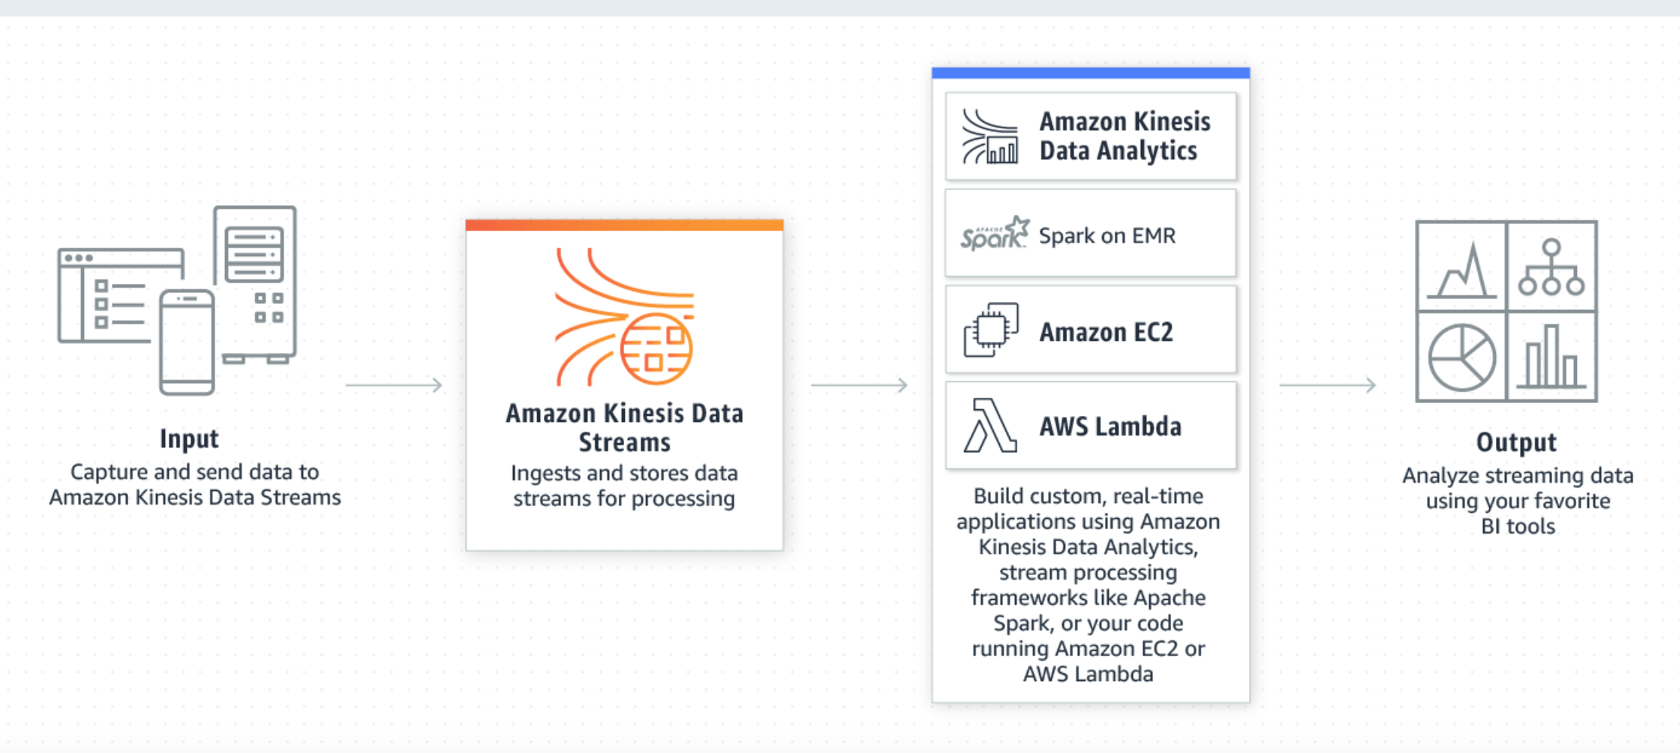
Amazon Kinesis Data Streams

Slide 8
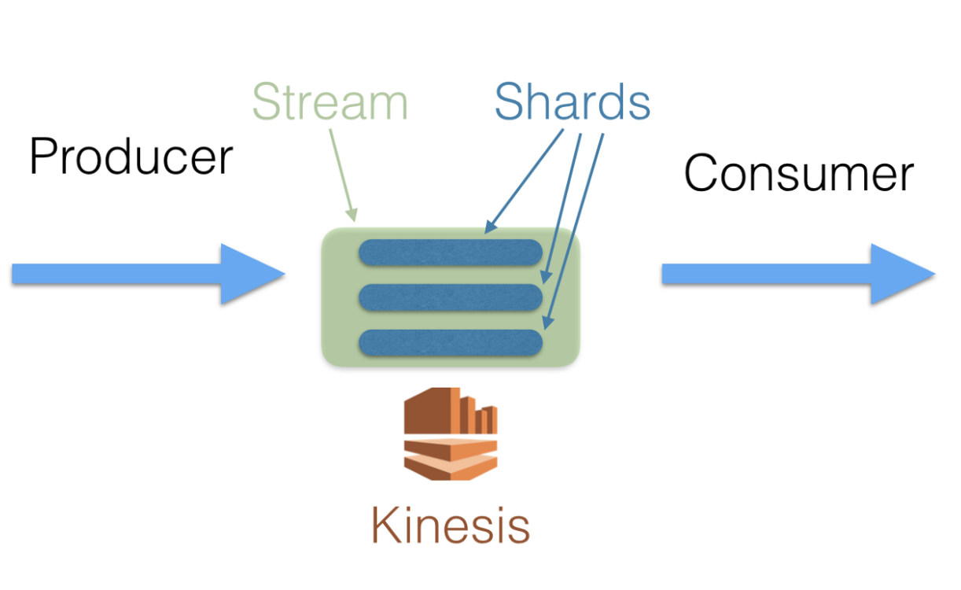
Terminologies
A stream: A queue for incoming data to reside in. Streams are labeled by a string. For example, Amazon might have an “Orders” stream, a “Customer-Review” stream, and so on
A shard: A stream can be composed of one or more shards. One shard can read data at a rate of up to 2 MB/sec and can write up to 1,000 records/sec up to a max of 1 MB/sec. A user should specify the number of shards that coincides with the amount of data expected to be present in their system. Pricing of Kinesis streams is done on a per/shard basis
Notes:
Shard is the base throughput unit of an Amazon Kinesis data stream. One shard provides a capacity of 1MB/sec data input and 2MB/sec data output.

Slide 9
Terminologies
Producer: A producer is a source of data, typically generated external to your system in real-world applications (e.g. user click data)
Consumer: Once the data is placed in a stream, it can be processed and stored somewhere (e.g. on a database). Anything that reads in data from a stream is said to be a consumer
Partition key: The partition key provided is used to determine which shard the data should be written to on the stream

Slide 10
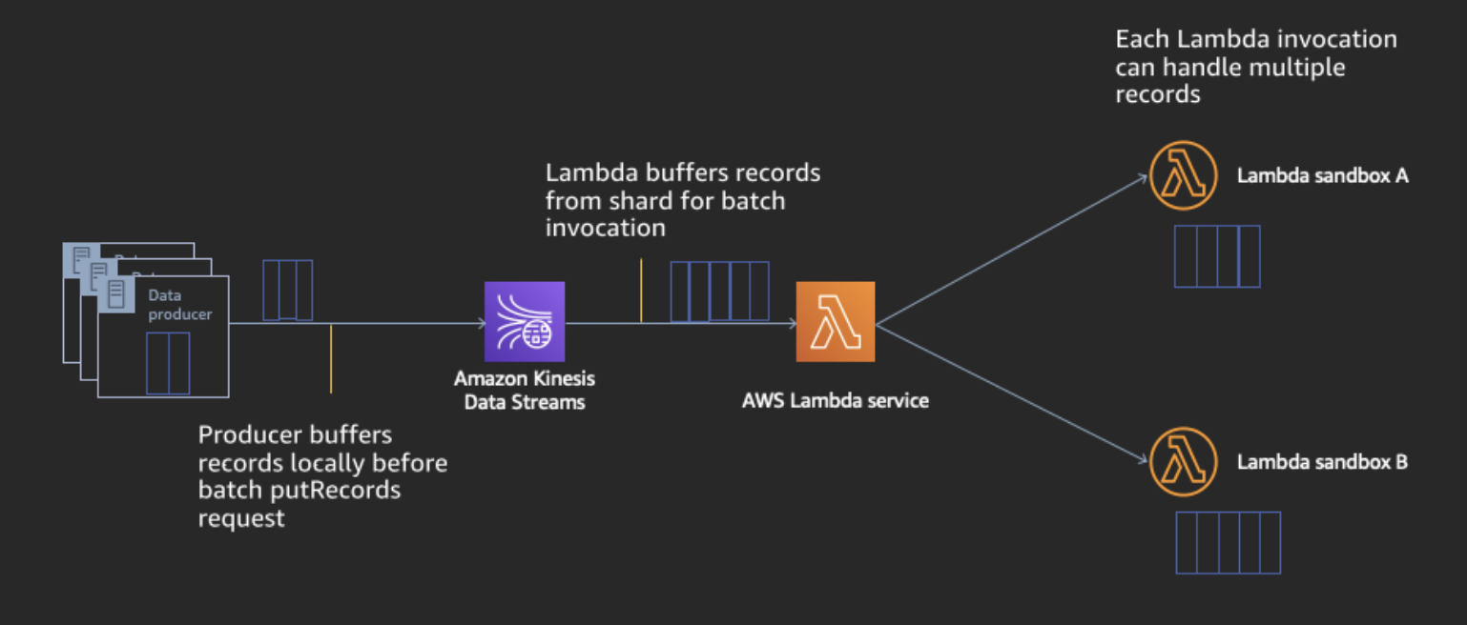
AWS Lambda
AWS Lambda as a stream consumer takes care of the operational overhead of reading shards, maintaining record order, check pointing as records are processed, and parallelizing processing
Event trigger
Real-time streams
Notes:
When configured with a Kinesis Stream as its event source, AWS Lambda continuously polls every shard in our stream at no extra charge and only invokes the Lambda code if and when there are messages in the stream. It additionally scales up the number of concurrent executions to parallelize reading all shards of a stream at the same time (and can have multiple executions reading the same shard simultaneously for a higher parallelization factor, if desired). AWS Lambda automatically checkpoints which records were successfully processed and handles retries and any failures automatically according to your desired configuration.
Best of all, there is no additional cost of the Lambda service handling all of these operational needs for you. You only pay for compute time when your function is invoked and messages are available on the stream for processing. You’re able to focus on processing your data with your business logic directly in your code since your records are sent as an array to your Lambda code. There is no additional code to author/manage regarding checkpointing, shard splits/merges, or other complexities.

Slide 11
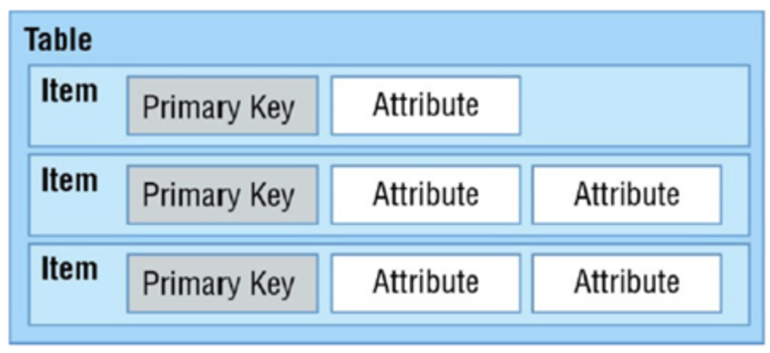
AWS DynamoDB
Amazon DynamoDB is a fast, fully-managed NoSQL database service that makes it simple and cost effective to store and retrieve any amount of data
DynamoDB has flexibility with database schema and only requires a primary key attribute
Each item, added to table can then add additional attributes. Thus easily, expand schema without having to rebuild entire table
Notes:
Scalable – User can store unlimited amount of data.
Distributed – DynamoDB scales horizontally by expanding a single table over multiple server
Cost Effective – One year free tier allows more than 40 million database operations/month and pricing is based on throughput (read/write per second) rather than storage
Automatic data replication – All data items are stored on Solid State Disks (SSDs) and automatically replicated across multiple availability zones in a region
Secure – DynamoDB uses proven secured methods to authenticate users and prevent unauthorized data access

Slide 12
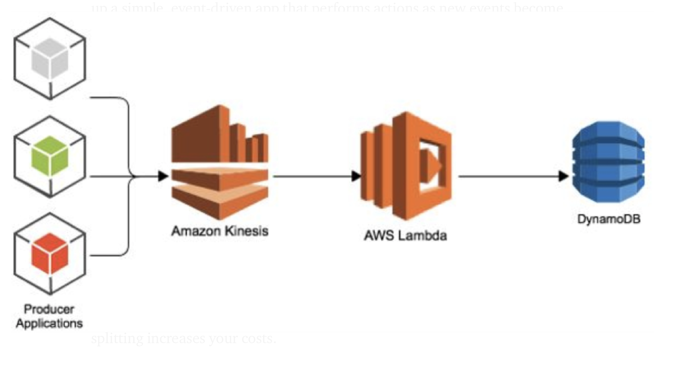

Architecture
Using our architecture we will demonstrate how one can ingest Twitter data into Kinesis, followed by invoking the Lambda code if and when there are tweets in the stream and store the tweet’s information (product review) we require in DynamoDB.

Slide 13
Cost of Running
We will be using the minimal amount of resources necessary for this demonstration, namely 1 stream and 1 shard in Kinesis, which costs less than $0.02 per hour. As per our compute needs AWS Lambda will cost us $0.20 per 1M requests or $0.0000166667 for every GB-second and DynamoDB will also cost less than $0.02 per hour

Slide 14
Steps to be followed
Prerequisites: Twitter API keys and AWS account
Feeding data from Twitter to a Kinesis stream
Verify that data is being written to Kinesis by checking the AWS console
Consume data from the Kinesis stream when a new stream is ready using AWS Lambda and store data in DynamoDB
Verify that items are being stored in DynamoDB by going to the AWS console and clicking on “items”

Slide 15
References
https://aws.amazon.com/kinesis/
https://aws.amazon.com/blogs/architecture/serverless-stream-based-processing-for-real-time-insights/
https://blog.insightdatascience.com/getting-started-with-aws-serverless-architecture-tutorial-on-kinesis-and-dynamodb-using-twitter-38a1352ca16d

Slide 16
Questions?

